Slide 1
UNIT- II ATTENTION & PERCEPTION
RAMESHBABU TAMARANA

Slide 2
Introduction
Definition
“Everybody knows what attention is. It is the taking possession of the mind, in clear and vivid form, of one out of what seem several simultaneously possible objects or trains of thought. Focalisation, concentration, of consciousness are of its essence. […] It implies withdrawal from some things in order to deal effectively with others […]” (William James in “principles of psychology”, in 1890)

Slide 3
Introduction
Attention is the cognitive process of selectively concentrating on one aspect of the external or internal environment while ignoring other aspects.
Experimental research on attention started in the 1950s.
Attention in perception
If we look around us we experience an amazing richness of detail.
But we do not notice the detail of objects unless attention is directed to them.
Demonstration
Close your eyes

Slide 4
Introduction
Another demonstration:
Change blindness- fail to notice a change in some part of the stimulus, example, Stranger-and-the-door study (Simons & Levin, 1998).
Inattentional blindness- occurs when we are paying attention to something, we fail to notice when an unexpected but completely visible object. For example, “invisible gorilla” experiment (Simons & Chabris, 1999).
The influence of attention on perception has implications.
- Eye witness testimony
- Driving a car in traffic

Slide 5

Different types of Attention
Covert Attention (Out of the eye)
Divided Attention
Selective Attention
Overt Attention
(Move eyes to look at something)

Slide 6
Different types of Attention Processes
Attention- the ability to focus on specific stimuli or location.
Selective Attention- the ability to focus on one aspect of the external or internal environment while ignoring other aspects.
Overt Attention- the process of shifting attention from one place to another by moving the eye.
Covert Attention- occurs when attention is shifted without moving the eyes.
Divided Attention- attending to two or more things at once.

Slide 7
Selective Attention
Selective Attention- is the process of focusing on one aspect of the external or internal environment while ignoring other aspects.
Two basic methods of selective attention:
1. Dichotic Listening (Collin Cherry, 1953)
2. Stroop Effect (J. R. Stroop, 1935)

Slide 8
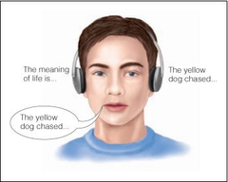
Dichotic Listening

Slide 9
Dichotic Listening
In a dichotic listening, different messages are presented to the two ears.
Participants are instructed to pay attention to the message presented to ear (attended message), repeating it out loud as they are hearing it.
To ignore the message presented to the other ear (unattended message).
The procedure of repeating a message out loud is called Shadowing.
The shadowing procedure is used to ensure that participants are focusing their attention on the attended message.
Cherry (1953) showed that a listener can attend to just one message.
Moray (1959) showed that participants were unaware of a word that had been repeated 35 times in the unattended ear.

Slide 10
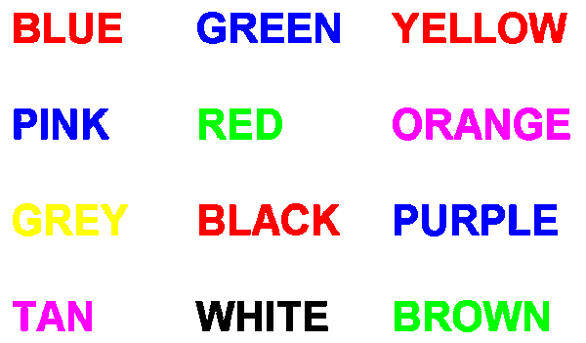
Stroop Effect
- Look at the figure and name, as quickly as possible, the colour of the ink, not the colour name that is spelled out.

Slide 11
Stroop Effect
According to the Stroop effect, people take a long time to name the ink colour when that colour is used in printing an incongruent word.
Why the stroop effect demonstrates selective attention?
People take longer to name a colour when they are distracted by another feature of the stimulus, namely, the meaning of the words themselves (Styles, 2006).

Slide 12
Review on Selective Attention
According to the research on dichotic listening, people usually have trouble picking up much information about the auditory message that they were instructed to ignore.
The research on the Stroop effect shows that people have trouble naming the colour of a stimulus when the letters of the stimulus are used to spell the name of a different colour.

Slide 13
Divided Attention
“Paying attention to two or more simultaneous messages, responding to each as needed”.
Research on divided attention shows that performance often suffers when people must attend to several stimuli simultaneously.
Example:
We cannot talk on a hands-free cell phone and drive carefully at the same time (Strayer et al., 2003).
People make more driving errors when they are either talking or listening, compared to driving without conversation (Kubose et al., 2006; Strayer & Drews, 2007).
However, with extensive practice, people’s performance on some divided attention tasks can improve (Wikman et al., 1998).

Slide 14
Models of Attention
A number of models have been proposed to explain the process of selective attention.
- Broadbent’s Filter Model of Attention (1958)
- Treisman’s Attenuation Theory of Attention (1964)
- Late Selection models (Deutsch & Deutsch,1963; Norman, 1968)
The debate over whether attention operates at an early or late stage highlighted two aspects of attention.
Attention can have an effect on the very earliest levels of perceptual processing by reducing the amount of information that enters into our cognitive system.
Some unattended information reaches very late stages of processing, which shows that not all unattended information is entirely filtered out. Information that is contextually consistent with our goals or likely to be of extreme importance, such as our name, penetrates the attentional filter.
Early Selection Models

Slide 15
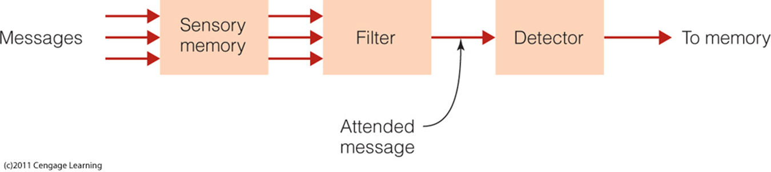
Broadbent’s Filter Model of Attention (1958)
Donald Broadbent (1958) created a model of attention to explain how selective attention is achieved.
Flow diagram of Broadbent’s Filter Model of Attention

Slide 16
Sensory memory
Holds all incoming information for a fraction of a second.
Transfers all information to next stage.
Filter
Identifies attended message based on physical characteristics- voice, pitch, speed of talking, and accent.
Only attended message is passed on to the next stage.
All other messages are filtered out.
Detector
Processes all information to determine higher-level characteristics of the message, such as its meaning.
Short-term memory
Receives the output of the detector.
Holds information for 10-15 seconds.
Transfers information into long-term memory.

Slide 17
Broadbent’s model has been called as Bottleneck Model.
Because the filter restricts information flow, much as the neck of a bottle.
Broadbent proposed that the filter restricts the large amount of information available to a person.
So, only some of this information gets through to the detector.
Filter lets information through based on specific physical characteristics of the information i.e., pitch of the speaker’s voice.

Slide 18
Problems with Broadbent’s model
According to Broadbent’s model, information in the unattended message should not be accessible to consciousness.
However, Neville Moray (1959) experiment shadowed the message presented to one ear and ignored the message presented to the other ear.
But when Moray presented the listener’s name to the other, unattended ear, about the third of the participants noticed it.
This phenomenon, in which a person is selectively listening to one message among many yet hears his or her name or some other distinctive message such as “Fire” that is not being attended, is called the Cocktail party effect (Wood & Cowan, 1995).

Slide 19
According to Broadbent’s theory, the filter is supposed to let through only one message, based on its physical characteristics.
But, Moray (1959) participants had recognized their names.
Following Moray’s lead, Gray & Wedderburn (1960) showed that information presented to the unattended ear is processed enough to provide the listener with some awareness of its meaning.

Slide 20
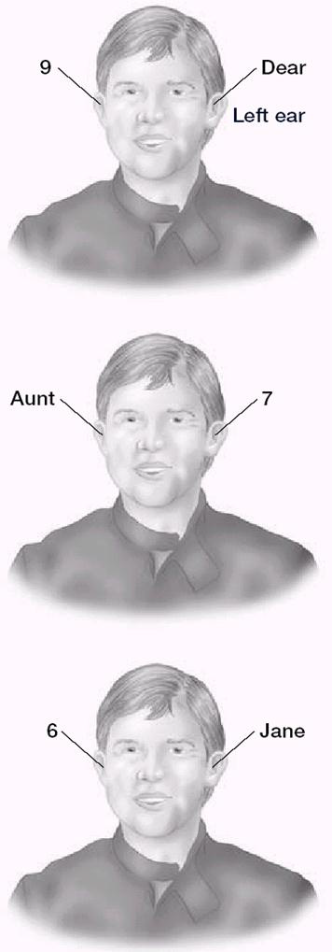
Gray & Wedderburn’s Experiment (1960)

Slide 21
“Dear Aunt Jane” Experiment
As in Cherry’s dichotic listening experiment, the participants were told to shadow the message presented to one ear.
The attended (shadowed) ear received the message “Dear 7 Jane”, and the unattended ear received the message “9 Aunt 6”.
Participants reported hearing “Dear Aunt Jane”, rather than “Dear 7 Jane”.
This occurred because they were taking the meaning of the words into account.

Slide 22
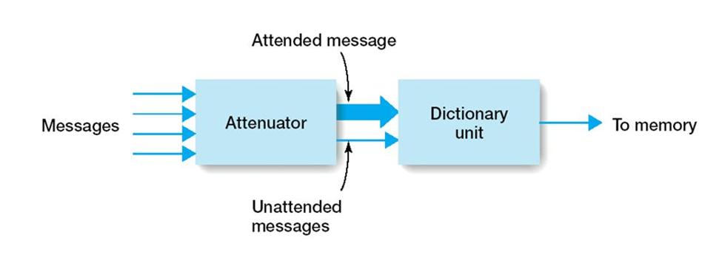
Treisman’s Attenuation Theory of Attention (1964)

Slide 23
Treisman’s Attenuation Theory of Attention (1964)
Replaced Broadbent’s filter with an attenuator.
Proposed that selection occurs in two stages.
Attenuator Stage
Dictionary Unit Stage
Attenuator analyzes the incoming message in terms of
1. Physical characteristics- high pitch or low pitch
2. Language- how the message groups into words
3. Meaning- how sequences of words create meaningful words
Note that this is similar to what Broadbent proposed.

Slide 24
But in Treisman’s theory language and meaning can be used to separate the messages.
For example, if there are 2 messages,
One in a male voice and one in a female voice, then analysis at the physical level is adequate to separate the low-pitched male voice from high-pitched female voice.
If the voices are similar, then it might be necessary to use meaning to separate the two messages.
Once the attended and unattended messages have been identified, both messages are let through the attenuator.
But the attended message emerges at full strength and the unattended messages are attenuated- they are still present, but are weaker than the attended message
Because at least some of the unattended message gets through the attenuator, it has been called as “leaky filter” model.

Slide 25
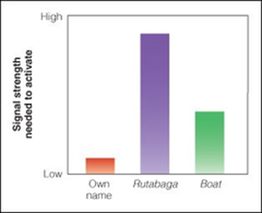

Slide 26
The final output of the system is determined in the second stage, when the message is analyzed by the dictionary unit.
The dictionary unit contains stored words, each of which has a threshold for being activated.
A threshold is the smallest signal strength that can barely be detected.
Thus, a word with a low threshold might be detected even when it is presented softly.
According to Treisman, words that are common or especially important, i.e., listener’s name, have low thresholds, so even a weak signal in the unattended channel can activate that word, and we hear our name from across the room.
Words that are unimportant to the listener have higher thresholds, so it takes the strong signal of the attended message to activate these words.
Thus, according to Treisman, the attended message gets through, plus some parts of the weaker unattended message.

Slide 27
Late Selection Models of Attention
Other experimental results showed that messages can be selected at a later stage of processing, based on primarily on their meaning.
For example, in an experiment by Donald MacKay (1973) listened to ambiguous sentences, such as “They were throwing stones at the bank”, that could be taken more than one way.
These ambiguous sentences were presented to the attended ear, while biasing words, such as “river” or “money” were being presented to the unattended ear.
After hearing a number of the ambiguous sentences, participants were presented with pairs of sentences such as the following.
They threw stones toward the side of the river yesterday.
They threw stones at the savings and loan association yesterday.
Participants indicated which of these 2 sentences was closest in meaning to one of the sentences they had heard previously.

Slide 28
For example, if the biasing word was “money”, participants were more likely to pick the second sentence.
This occurred even though participants reported that they were unaware of the biasing words that had been presented to the unattended ear.
Because the meaning of the unattended word (money) was affecting the participant’s judgment, this word must have been processed to the level of meaning.
This research results led to other researchers to propose late selection models of attention.
Late selection models of attention proposed that ‘most of the incoming information is processed to the level of meaning before the message to be processed is selected’ (Deutsch & Deutsch, 1963; Norman, 1968).

Slide 29
The selective attention research we have been describing centered around when selective attention occurs (Early of late) & what types of information are used for the selection (physical characteristics or meaning).
As research in selective attention has progressed, researchers have realized that there is no one answer to what had been called the “early-late” controversy.
Early selection can be demonstrated under some conditions and later selection under others, depending on the observer's task and the type of stimuli presented.
Thus, researchers began focusing on factors that control attention.
Cognitive Resources
Cognitive Load

Slide 30
Cognitive resources refer to the idea that a person has a certain cognitive capacity, which can be used for carrying out various tasks.
Cognitive load is the amount of a person’s cognitive resources needed to carry out a particular cognitive task.
Easy, and well practiced tasks have low cognitive tasks; these low-load tasks use only a small amount of the person’s cognitive resources.
Difficult and not well practiced tasks, are high-load tasks use more of a person’s cognitive resources.
Lavie (1995, 2005) has proposed that “the amount of cognitive resources that remain as a person is carrying out a primary task determines how well the person can avoid attending to task-irrelevant stimuli”.

Slide 31
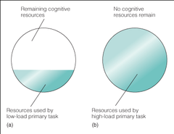
The circle represents a person’s total cognitive resources.
Shading represents the portion that is used up by a low-load primary task.

Slide 32
In figure a, only part of the person’s resources are being used by a low-load primary task, leaving resources available for processing other stimuli that may be present.
This can occur even if the person does not intend to process these other stimuli.
For example, a person is sitting in his/her room listening to music, which uses only a portion of his/her cognitive resources, so the voices of people talking in the hall intrude even though the person would rather not hear them.
Stimuli such as talking in the hall are task irrelevant stimuli that have made use of some of the person’s remaining cognitive resources.
Example: Flanker Compatibility Task

Slide 33
Flanker Compatibility Task
The flanker compatibility task, in which participants are told to carry out a task that requires them to focus their attention on specific stimuli and to ignore other stimuli (Eriksen & Eriksen, 1974).
Stimulus | Flankers | Typical Result
B A B | Compatible | Fastest response to target
C A C | Incompatible | Slowest response to target
X A X | Neutral | Intermediate response to target

Slide 34
The task is to selectively attend to the target in the center position (A in this example) and to press the “z” key if A or B is presented in the center and the “m” key if C or D is presented.
Participants are told to ignore the “flanker” stimuli that are presented on either side because these are task-irrelevant stimuli that aren’t needed for the primary task.
One target stimulus is presented in the central position on each trial, and this target is flanked on either side by A, B, C, D, or X.
In figure a, the flankers are associated with the same response as the target (pushing the z key is the response for both). These flankers (B’s) are therefore called compatible flankers.
In figure b, the flankers (C’s) are associated with a different response (pushing the ‘m’ key) than the target; these are called incompatible flankers.
In figure c, the flankers (X) are neutral; they aren’t associated with any response.

Slide 35
When participants try to respond to the target as quickly as possible, they typically respond more slowly when incompatible flankers are present (as in b) than when neutral flankers (c) or compatible flankers (a) are present.
This occurs because the incompatible flanker elicits a response that is different from the one that is required for the target and therefore competes with the response that the participant is supposed to make to the target.
The fact that the flanker has this effect demonstrates that even though participants were told to ignore the flankers, they still processed information from them.

Slide 36


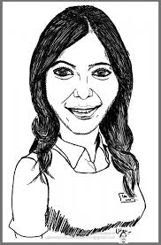
Who are the people in figure?

Slide 37
Your skill at identifying each of these caricatures suggests that your perception of the world relies on more than just the information arriving at your sensory receptors.
Your ability to transform and interpret sensory information.
your ability to have what you know interact with what you see—allows you to recognize Narendra Modi, Samantha, and Kamal Hasan from these exaggerated portraits.

Slide 38
Our environment is filled with waves of light and sound, but that’s not the way in which we experience the world.
We don’t ‘‘see’’ waves of light; we see a poster on the wall.
We don’t ‘‘hear’’ waves of sound; we hear music from a nearby radio.
Sensation is what gets the show started, but something more is needed to make a stimulus meaningful and interesting and, most important, to make it possible for us to respond to it effectively.
The processes of perception provide the extra layers of interpretation that enable us to navigate successfully through our environment.
A small Demonstration to help you think about the relationship between sensation and perception.

Slide 39
Perceptual processes extract meaning from the continuously changing, often chaotic, sensory input from external energy sources and organize it into stable, orderly percepts.
A percept is what is perceived- the experienced, outcome of the process of perception. It is not a physical object or its image in a receptor but, rather, the psychological product of perceptual activity.
Thus your percept of your hand remains stable over changes in the size of the image because your interpretation is governed by stable perceptual activities.

Slide 40
The process of perception is best understood when we divide it into three stages:
1. Sensation
2. Perceptual organization, and
3. Object recognition.
Sensation refers to conversion of physical energy into the neural codes recognized by the brain.
Sensation provides a first-pass representation of the basic facts of the visual field.

Slide 41
Perceptual Organization
Perceptual organization, in which an internal representation of an object is formed and a percept of the external stimulus is developed.
The goal of understanding "perceptual organization" is to understand how we put together the basic features to see a coherent, organized world of things and surfaces.
Aspects of perceptual organization were first studied systematically in the early 1900s by gestalt psychologists.
The basic motto of the Gestaltists - was “whole is greater than the sum of its parts”.
Examples: a melody made a various notes.

Slide 42
The first step in organizing the perceptual world is to divide figure and ground.
The figure, which has a definite shape and location in space; in other words, the figure is the integrated visual experience that stands out at the center of attention.
The ground, which has no shape, seems to continue behind the figure, and has no definite location. In other words, the ground is simply the background against which the figure appears.

Slide 43


Slide 44
For instance, if you are looking at a ball that is resting on a field of grass, the ball is the figure and the ground consists of many lengthened shapes (the blades of grass).
Sometimes, figure and ground can change, as in the famous “face-vase”.

Slide 45


Slide 46
The explanation for these figure-ground reversals has two components.
1. Neurons in the visual cortex become adapted to one figure, such as the “faces” version, so you are more likely to see the alternative or “vase” version.
2. People try to solve the visual paradox by alternating between two reasonable solutions.
We can also perceive a figure-ground relationship when a scene has no clear-cut boundary between the figure and the ground.
Ex. Illusory contours (subjective contours), in which we see edges even though they are not physically present in the stimulus.

Slide 47

People report that an inverted white triangle seems to appear in front of the outline of a second triangle and three small circles.
Furthermore, the triangle appears to be brighter than any other part of the stimulus.

Slide 48
How we perceive these illusory contours:
During the early stages of visual processing, some cells in the visual system respond to these illusory contours (Grossberg, 2003).
During the later stages, the visual system tries to make sense of this disorderly jumble. For example, an efficient explanation for the jumble in figure is that a white triangle is located in front of the other figures.

Slide 49
Laws of Organization (or) Grouping
There are laws that explain form perception. Known as laws of grouping-basic ways in which we group items together perceptually.
1. Proximity
2. Similarity
3. Good continuation
4. Closure
5. Pragnanz

Slide 50

- Law of Proximity says that elements close to one another tend to be perceived as a unit.

Slide 51

- Law of Similarity says that objects that are similar tend to be grouped together.

Slide 52
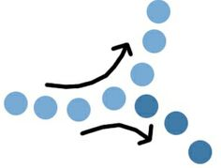
- Law of Good continuation says that elements that appear to follow in the same direction tend to be grouped together. That is, there is a tendency to perceive continues patterns in stimuli rather than abrupt changes.

Slide 53

- Law of Closure says that when a space is enclosed by a contour it tends to be perceived as a figure. Closure also refers to the fact that certain figures tend to be perceived as more complete or closed than they are.

Slide 54
Law of Pragnanz includes other laws and says that perceptual organization will always be as regular, simple, and symmetric as possible.

Slide 55
Object Recognition
During the final stage of perceptual processing- object recognition - percepts are given meaning through processes that combine bottom-up and top-down processes.
Context, expectations, and perceptual sets may guide recognition of incomplete or ambiguous data in one direction rather than another, equally possible one.
Perception thus depends on what you know and expect as well as on the sensory stimulus.

Slide 56
Bottom-up & Top-down Processes
When we identify an object, we must match what we see against our stored knowledge.
Taking sensory data into the system and sending it upward for extraction and analysis of relevant information is called bottom-up processing.
Bottom-up processing is anchored in empirical reality and deals with bits of information and the transformation of concrete, physical features of stimuli into abstract representations.
This type of processing is also called data-driven processing, because your starting point for identification is the sensory evidence you obtain from the environment.

Slide 57
When your memories and expectations affect perception, it is called top-down processing.
Top-down processing involves your past experiences, knowledge, motivations, and cultural background in perceiving the world.
With top-down processing, higher mental functioning influences how you understand objects and events.
Top-down processing is also known as conceptually driven (or hypothesis driven) processing, because the concepts you have stored in memory are affecting your interpretation of the sensory data.

Slide 58
Theories of Object Recognition
Researchers have proposed several theories of object recognition.
1. Template-Matching Theory
2. Interactive Activation Model
2. Feature-Analysis Theory
3. The Recognition-by-Components Theory

Slide 59
Template-Matching Theory
The template-matching theory, states that a stimulus is compared with a set of templates, or specific patterns stored in memory. After comparison, the person notes the template that matches most closely.
‘Template’ is a specific perceptual pattern stored in memory.
Multiple templates are held in memory.
Templates are created by experience.
To recognize the incoming stimuli, you compare to templates in memory until a match is found.

Slide 60
Template models work only for isolated letters, numbers, and other simple two-dimensional objects presented in their complete form (Palmer, 2003).
A template system may work well for computers that process a standardized set of numbers. Ex. Machine recognition
Weakness of theory
Templates are totally inadequate for explaining the complex process of object recognition in humans. If a letter differs from the appropriate template even slightly, the pattern cannot be recognized.

Slide 61
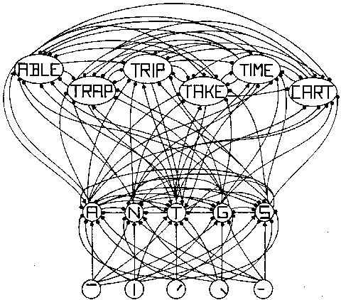
Interactive Activation Model

Slide 62
Interactive Activation Model
Interactive activation model (McClelland & Rumelhart, 1981; Rumelhart & McClelland, 1982).
A model of letter and word recognition.
Inspired by Hubel & Wiesel (1965) who discovered there are neurons in the visual cortex which only responds to certain kinds of stimuli
Proposed that recognizing words is based on activation of feature-detector-like units that are arranged in layers.
Units that respond to simple features, such as line orientation or combinations of lines, are in lower layers, and
Units that respond to words are in the upper layer.

Slide 63
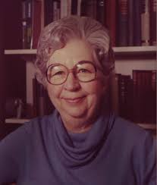
Feature Analysis Theory
Visual stimulus is composed of many features with distinctive forms.
Features of objects and patterns are extracted and matched to features in memory for recognition.
We can decompose the letter “A” into at least three features (/ -\) or line segments.
Eleanor Gibson (1910-2002)

Slide 64
When we look at a new letter, our visual system notes the presence or absence of the various features.
It then compares this list with the features stored in memory for each letter of the alphabet.
The feature-analysis theories propose that the distinctive features for each alphabet letters remain constant, whether the letter is handwritten, printed, or typed.
Feature analysis model explain how we perceive a wide variety of two-dimensional patterns, such as figures in a painting, designs on fabric, and illustrations in books.

Slide 65
Eleanor Gibson (1969) demonstrated that people require a relatively long time to decide whether one letter is different from a second letter when those two letters share a large number of critical features.
The letters P and R share many critical features; Gibson’s research participants made slow decisions about whether these two letters were different.
In contrast, O and L do not share any critical features; People decided relatively quickly whether letter pairs like these were different from each other.

Slide 66
Criticism
Theory of object recognition should not simply list the features contained in a stimulus; it must also describe the physical relationship among those features (Groome, 1999).
For example, in the letter T, the vertical line supports the horizontal line. In contrast, the letter L consists of a vertical line resting at the side of the horizontal line.
Feature-analysis theory was constructed to explain the relatively simple recognition of letters. In contrast, the shapes that occur in nature are much more complex (Kersten et al., 2004).

Slide 67
How can you recognize a horse?
Do you analyze the stimulus into features such as its mane, and its head?
Horses and other objects in our environment contain far too many lines and curved segments, and the task is far more complicated than letter recognition (Palmer, 2003; Vecera, 1998).
The final approach to object recognition, addresses how people recognize these more complex kinds of stimuli found in everyday life.

Slide 68
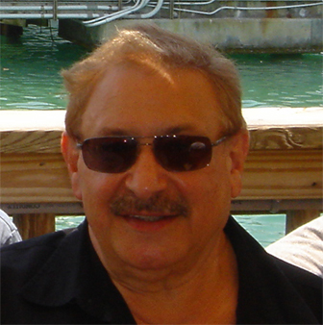
The Recognition-by-Components Theory
The basic assumption of the theory is that a specific view of an object can be represented as an arrangement of simple 3-D shapes called ‘Geons’ (geometric icons).
Biederman (1987) suggested that we perceive objects by using “Geons”.
He lists 36 Geons for 3-D recognition.
Geons can be combined to form meaningful objects.

Slide 69
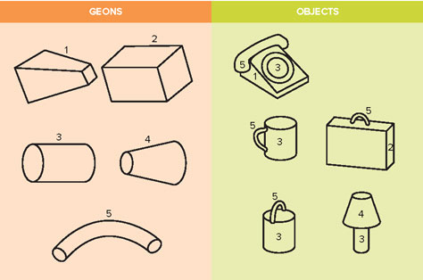
Geons and Objects Geons are elements that form 3D objects.

Slide 70
Face Perception
People can quickly recognize the faces of people they know; we seem to process a face in terms of its gestalt, or its overall shape and structure.
You can recognize the face of your friend even when you see his/her face from a different angle, and in an unusual setting. Impressively, you manage to overcome all these sources of variation (Esgate & Groome, 2005; McKone, 2004; Styles, 2005).

Slide 71
Laboratory-based research
Tanaka & Farah (1993) found that people were significantly more accurate in recognizing facial features when they appeared within the context of a whole face, rather than in isolation.
In contrast, when they judged houses, they were just as accurate in recognizing an isolated house feature (such as a window) as in recognizing house features within the context of a complete house.
We recognize objects-such as houses-by identifying the individualized features that combine together to create these objects.
In contrast, we recognize faces on a holistic basis-that is, in terms of their overall shape and structure.

Slide 72
Neuroscience research
Neuroscience research on face recognition comes from people with brain lesions. Brain lesions refers to the destruction of tissue, most often by strokes, tumors, or accidents.
McNeil & Warrington (1993) studied a professional man who lost his ability to recognize human faces after he had experienced several strokes. He began to raise sheep. Amazingly, he could recognize many of his sheep’s faces, even though he still could not recognize human faces.
‘Prosopagnosia’ is a condition in which people cannot recognize human faces visually, though they perceive other objects relatively normally (Farah, 2004).
Many neuroscience case studies show that individuals with prosopagnosia can easily recognize common objects.
For example, a man with prosopagnosia may quickly identify a chair, a coffee cup, or a sweater. He may even look at a woman’s smiling face and report that she looks happy. However, he may fail to recognize that this woman is his own wife (Farah, 2004; Palmer, 1999).

Slide 73
Applied research
The applied research on face recognition focuses on real-life situations that assess our ability to recognize people’s faces.
Kemp et al., (1997) studied the accuracy of supermarket cashiers who had been instructed to make judgments about ID photos. Specifically, undergraduate students were given credit cards that showed a 1'' × 1'' color photo.
Each student was told to select some items at a supermarket and then present his or her credit card to the cashier. The cashier could then decide whether to accept or reject the credit card.
When students carried a credit card that showed their own photo, the cashiers correctly accepted the card 93% of the time.
However, when students carried a card that showed a photo of another person- who looked fairly similar- they correctly rejected the photo only 36% of the time.
In other words, they let someone with an incorrect photo ID slip pass them 64% of the time.

Slide 74
Speech Perception
During speech perception, your auditory system record the sound vibrations generated by someone talking; then the system translate these vibrations into a sequence of sounds that you perceive to be speech.
Adults who speak English produce about 15 sounds every second (Kuhl, 1994).
In order to perceive a word, you must distinguish the sound pattern of one word from the tens of thousands of irrelevant words that are stored in your memory.

Slide 75
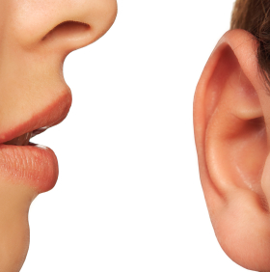
Speech Perception
How do we perceive speech?
Individual sounds (phonemes)?
Syllables?
Words?
Sentences?

Slide 76
Phoneme is the smallest distinctive sound unit of spoken language.
To say bat we utter the phonemes b, a, and t.
Linguists surveying nearly 500 languages have identified 869 different phonemes in human speech (Holt, 2002; Maddieson, (1984).
No one language uses all of them. English uses about 40 to 45.
Syllable- basic unit of speech generally containing only one vowel sound with or without surrounding consonants, forming the whole or a part of a word.
The word basic contains two syllables (ba-sic)

Slide 77
Characteristics of speech perception
Listeners can impose boundaries between words, even when these words are not separated by silence.
Phoneme pronunciation varies tremendously.
Context allows listeners to fill in missing sounds.
Visual cues from the speaker’s mouth help us interpret ambiguous sounds.

Slide 78
Word Boundaries.
Have you ever heard a conversation in an unfamiliar language?
The words seem to run together in a continuous stream, with no boundaries of silence to separate them.
You may think that the boundaries between words seem much more distinct in English-almost as clear-cut as the white spaces that identify the boundaries between the words in this textbook.
In most cases, however, the actual acoustical stimulus of spoken language shows no clear-cut pauses to mark the boundaries.
An actual physical event-such as a pause-marks a word boundary less than 40% of the time (Davis et al., 2002; Flores d’Arcais, 1988; McQueen, 2005).

Slide 79
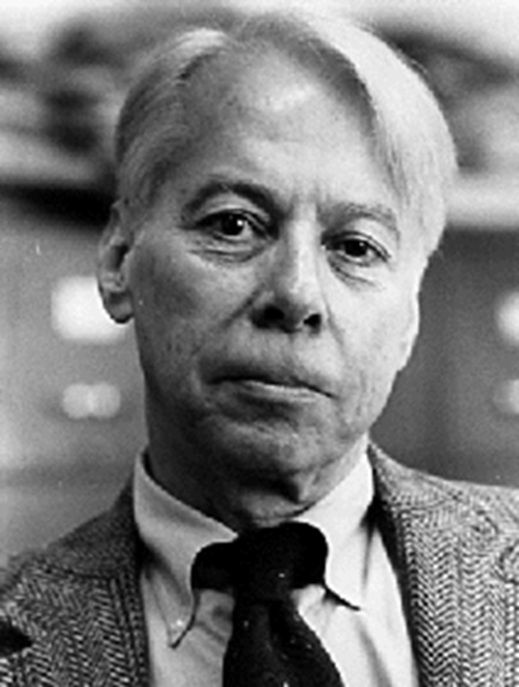
Research shows that our speech recognition system initially considers several different hypotheses about how to divide a phrase into words.
This system immediately and effortlessly uses our knowledge about language in order to place the boundaries in appropriate locations (Grossberg et al., 2004; McQueen, 2005; Vroomen & de Gelder, 1997).
Liberman and colleagues (1957) showed a phoneme boundary effect:
A smaller change in delay was necessary to distinguish /b/ from /p/.

Slide 80
Variability in Phoneme Pronunciation
Speakers vary tremendously in the pitch and tone of their voices, as well as their rate of producing phonemes.
Speakers often fail to produce phonemes in a precise fashion (Plack, 2005).
Coarticulation: when you are pronouncing a particular phoneme, your mouth remains somewhat the same shape as it was in pronouncing the previous phoneme; furthermore, your mouth is also preparing to pronounce the next phoneme-all at the same time.
As a result, the phoneme you produce varies slightly from time to time, depending upon the surrounding phonemes. For example, notice that the d in idle sounds different from the d in don’t.

Slide 81
Context and Speech Perception
People are active listeners, instead of passively receiving speech sounds, people use context as a cue to help them figure out a sound or a word.
Top-down processes influence our speech perception, because we use our vast knowledge about language to help us perceive ambiguous words.
For example, when you are listening to your professors’ lectures, extraneous noises will sometimes mask a phoneme. People knock books off desks, cough, turn pages, and whisper.
Still, without much effort, you can usually reconstruct the missing sound.
People tend to show phonemic restoration: They can fill in a missing phoneme, using contextual meaning as a cue (Grossberg, 2003).

Slide 82
Visual Cues as an Aid to Speech Perception
Information from the speaker’s lips and face helps resolve ambiguities from the speech signal, much as linguistic cues help us choose between wheel and heel (Dodd & Campbell, 1986).
Similarly, you can hear conversation more accurately when you closely watch a speaker’s lips, instead of listening to a conversation over the telephone (Massaro & Stork, 1998).

Slide 83
McGurk Effect
McGurk & McDonald (1976) provided a classic illustration of the contribution of visual cues to speech perception.
These researchers showed participants a video of a woman whose lips were producing simple syllables, such as “gag.” Meanwhile, the researchers presented different auditory information (coming from the same machine), such as “bab.”
When the observers were asked to report what they perceived, their responses usually reflected a compromise between these two discrepant sources of information.
In this case, the listeners typically reported hearing the word “dad.”
The McGurk effect refers to the influence of visual information on speech perception, individuals must integrate both visual and auditory information.

Slide 84
Theories of speech perception
According to the special mechanism approach humans are born with a specialized device that allows us to decode speech stimuli.
As a result, we process speech sounds more quickly and accurately than other auditory stimuli, such as instrumental music.
Supporters of this approach argue that humans possess a phonetic module, a special-purpose neural mechanism that specifically handles all aspects of speech perception; it cannot handle other kinds of auditory perception.

Slide 85
The general mechanism approach argue that we can explain speech perception without proposing any special phonetic module.
People who favor these approaches believe that humans use the same neural mechanisms to process both speech sounds and non-speech sounds.
Speech perception is therefore a learned ability—indeed, a very impressive learned ability—but it is not really “special.”
The current research suggests that humans perceive speech sounds in the same way we perceive non-speech sounds.

